Slide 1

WELCOME TO ENGLISH CLASS

Slide 2


WELCOME TO ENGLISH CLASS
“It’s not about ideas. It’s about making ideas happen.”
Scott Belsky, co-founder of Behance

Slide 3
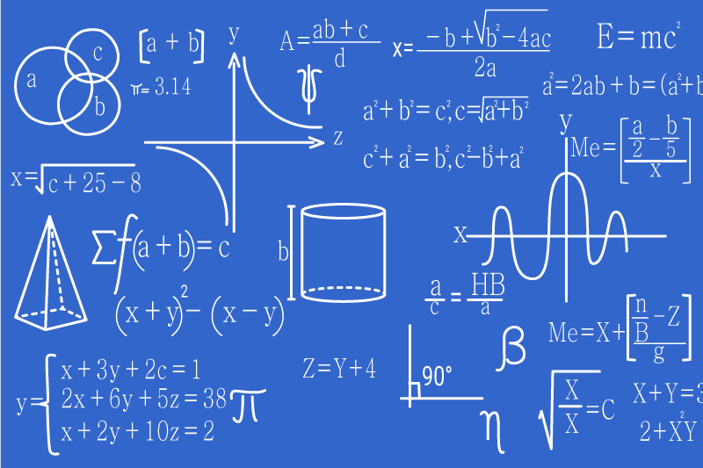




CONDITIONALS IN ALGORITHMS

Slide 4

DATE
DATE
Objective:
Students will be able to create an algorithm using CONDITIONALS to describe real-life situations.

Slide 5

AGENDA
WARM UP:
Match the sentences
CLASS ACTIVITY:
New Vocabulary
Reading Strategy: Previewing and Predicting
Reading: Conditionals and how they are used in Algorithms
Wrap- Up
Write a conditional in the situations

Slide 6

WARM-UP
Match parts of the sentences from the three columns to make logical statements.
If you like fast food, | then take sunglasses, | else study something else.
If you like felines, | then study programming, | else get a dog.
If you have a facemask, | then go to McDonald´s, | else take an umbrella.
If you are good at Mathematics, | then get a cat, | else stay at home.
If it is sunny, | then you can go outside, | else eat vegetables.

Slide 7

VOCABULARY
Else -> diferente o si no
Devices -> dispositivos
Complex ->complejo
Choices -> escoger
Several ->varios
both ->ambos
at least -> al menos
Check ->comprobar
Withdraw -> retirar , tomar algo
ATM -> cajero

Slide 8
Video Reading Strategy
https://www.youtube.com/watch?v=5g3dY0SfmtI

Slide 9
Conditionals and how they are used in Algorithms
Conditionals and how they are used in Algorithms
A CONDITIONAL is a type of a step in an algorithm where a decision must be made. In this article, we will focus on two types of CONDITIONALS: IF-THEN-ELSE and AND/OR conditionals.
IF-THEN-ELSE CONDITIONALS
One of the first things that programmers learn is how to use IF-THEN-ELSE conditionals. The basic idea is: IF some condition is true THEN do this, ELSE do that.
*imagen de un(a) estudiante conectado(a) a una clase virtual*
For example, imagine you have to connect to an online class, and you have two devices: a computer and a cellphone. You prefer to use the computer, but your computer is sometimes blocked. So the CONDIIONAL for your situation is: IF the computer works well THEN connect with the computer, ELSE connect with the cellphone.
Sometimes, you can have complex conditional statements when you have more than two choices. As humans, make decisions with several options in a very different way than computers. We have the ability to select one item out of a group of choices, but a computer program has to make binary decisions, meaning that it can only select between two things at a time.

Slide 10
Conditionals and how they are used in Algorithms
*imagen que consiste de tres partes: una parte – pizza, otra parte – hot-dog, otra parte – hamburguesa*
Imagine you want to go to a restaurant. You top-favorite is a pizza restaurant, your second favorite is a hot-dog restaurant, and your third favorite is a burger restaurant. There are no more restaurants in your town. Your CONDITIONAL for this situation is:
• IF pizza restaurant is open,
o THEN go to pizza restaurant
• IF hot-dog restaurant is open,
o THEN go to hot-dog restaurant
• IF burger restaurant is open,
o THEN go to burger restaurant
• ELSE cook at home
All the options after the one that is selected are completely ignored. For example, if the pizza restaurant is open, the computer program will ignore hot-dog and burger restaurants. When writing your program, it is important to think about the priorities.

Slide 11
Conditionals and how they are used in Algorithms
AND/OR CONDITIONALS
If you want to check multiple conditions, you can use AND/OR statements. Using AND will cause the program to do something if both conditions are true. Using an OR statement will do something if one of the conditions is true.
*imagen de un niño/niña jugando futbol, otra – sacando un perro, otra – estudiando*
Imagine you want to go to play soccer, but your mother says that you should do homework and walk the dog first. For this situation, the CONDITIONAL is: IF I finished homework AND I walked the dog, THEN I go to play soccer, ELSE I stay at home. Now, imagine a different situation – you want to participate in a school competition in Mathematics; to participate, you have to study minimum in the 9th grade or you have to be minimum 15 years old. In this case, the CONDITIONAL is: IF I study in 9th grade or higher OR I am at least 15 years old, THEN I can participate in Mathematics competition, ELSE I cannot participate.

Slide 12

WRAP-UP
Write a CONDITIONAL for each situation using the programming language learned today : : IF, THEN, ELSE, AND, OR.
Your flight is at 5 pm. You have to be at the airport at least 1 hour before. You get to the airport on time, you take the flight. You don´t get to the airport on time, you buy a new ticket.
2. You want to withdraw 10 000 pesos from the ATM. You have 10 000 or more in your account, you get the money. You have less than 10 000 in your account, you get nothing.
3. You want to take salsa classes. Salsa classes start at 3 pm. Your university classes finish before 3 pm, you take salsa classes. Your university classes finish after 3 pm, you don´t take salsa classes.

Slide 13

SELF-EVALUATION
1. La estrategia de Previewing & Predicting me ayudó a tener una idea de qué se trata el texto.
Si No Tal vez
2.Entiendo cómo se usan los CONDICIONALES en algoritmos.
Si No Tal vez
3. Puedo aplicar los CONDICINALES a situaciones de vida cotidiana.
Si No Tal vez

